Slide 1

Exploratory Data Analysis
Go To Market Insight for Cab Investment Firm
By Pamela S. D Martey - Intern
May 2024

Slide 2

Agenda
Executive Summary
Problem Statement
Approach
EDA
EDA Summary
Recommendations

Slide 3
Executive Summary
The Client: XYZ is a private firm in the US.
The Goal: To understand the market of the taxi industry before investing. The two top companies on the market are `Yellow Cab` and `Pink Cab`

Slide 4
Problem Statement
XYZ, a private firm in the US, is considering an investment in the Cab industry due to its remarkable growth in the last few years and the presence of multiple key players in the market. As part of their Go-to-Market(G2M) strategy, they are seeking to understand the market better before making a final decision.

Slide 5
Areas to Investigate
Is there any seasonality in number of customers using the cab service?
Which company has the maximum cab users at a particular time period?
Does margin proportionally increase with increase in number of customers?
What are the attributes of these customer segments?
Are there cities with higher cab users?

Slide 6
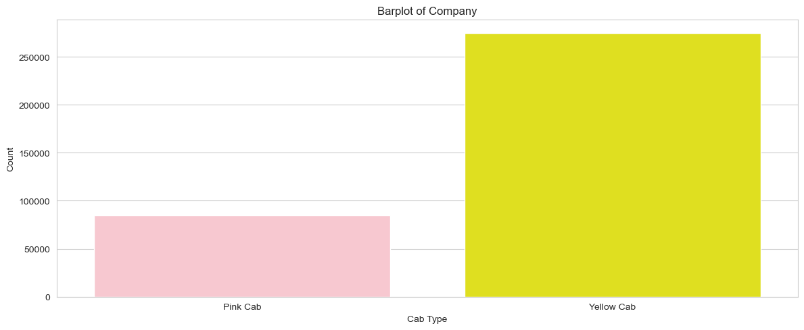
Exploratory Data Analysis
Bar Plot by Cab Type

Slide 7
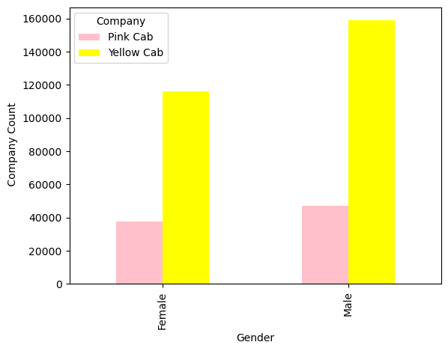
Bar Plot By Gender
The number of both male pink and yellow cab users are higher than females

Slide 8
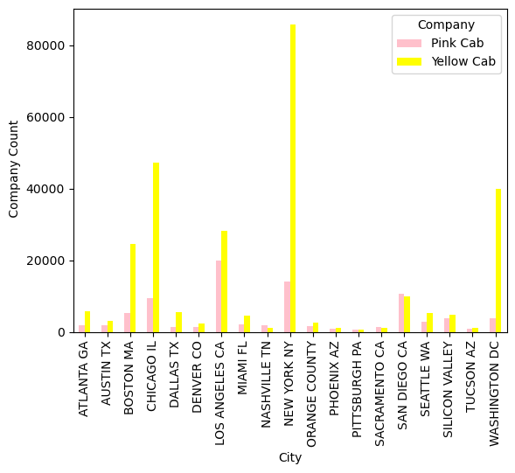
Bar Plot by Cities
NEW YORK NY has the highest number of rides vs PITTSBURGH PA with lowest

Slide 9
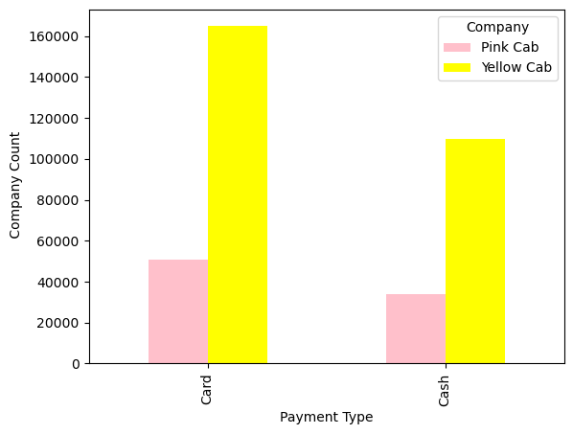
Bar Plot by Payment Method
The number of customers paying by card is relatively higher for pink and yellow cab users than payment by cash.

Slide 10
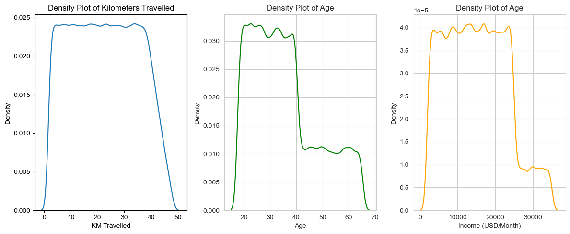
Distributions of Continuous Variables

Slide 11
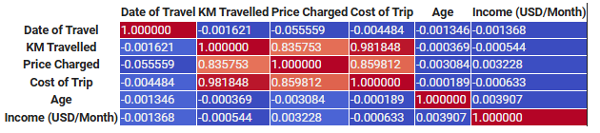
Correlation Matrix
Features such as KM Travelled, Price Charged and Cost of Trip are highly positively correlated
Whereas Date of Travel, age and monthly income do not correlate.

Slide 12
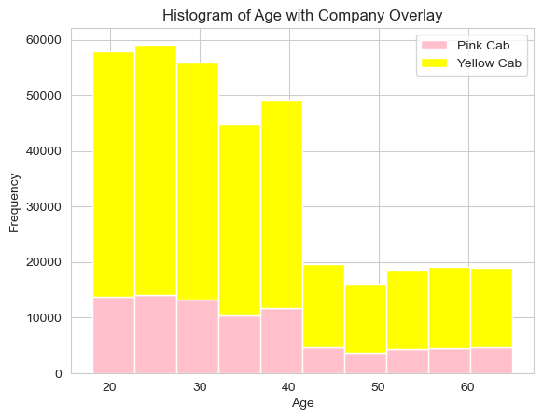
Histogram of Age with Company Overlay

Slide 13
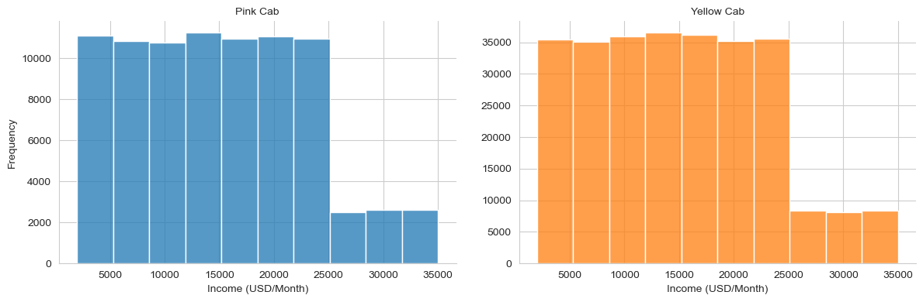
Histogram of Income

Slide 14
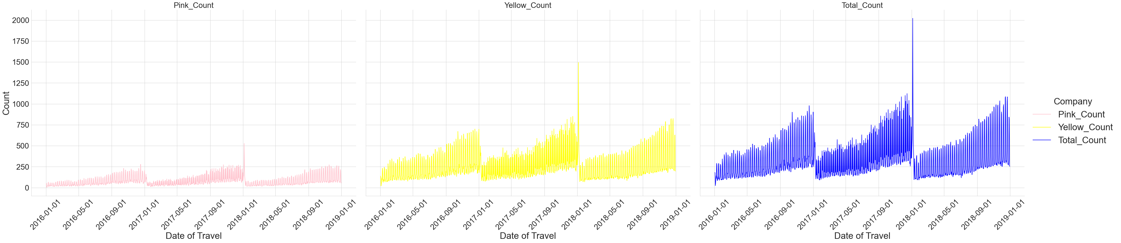
Line Plot of the Number of Trips by Time

Slide 15
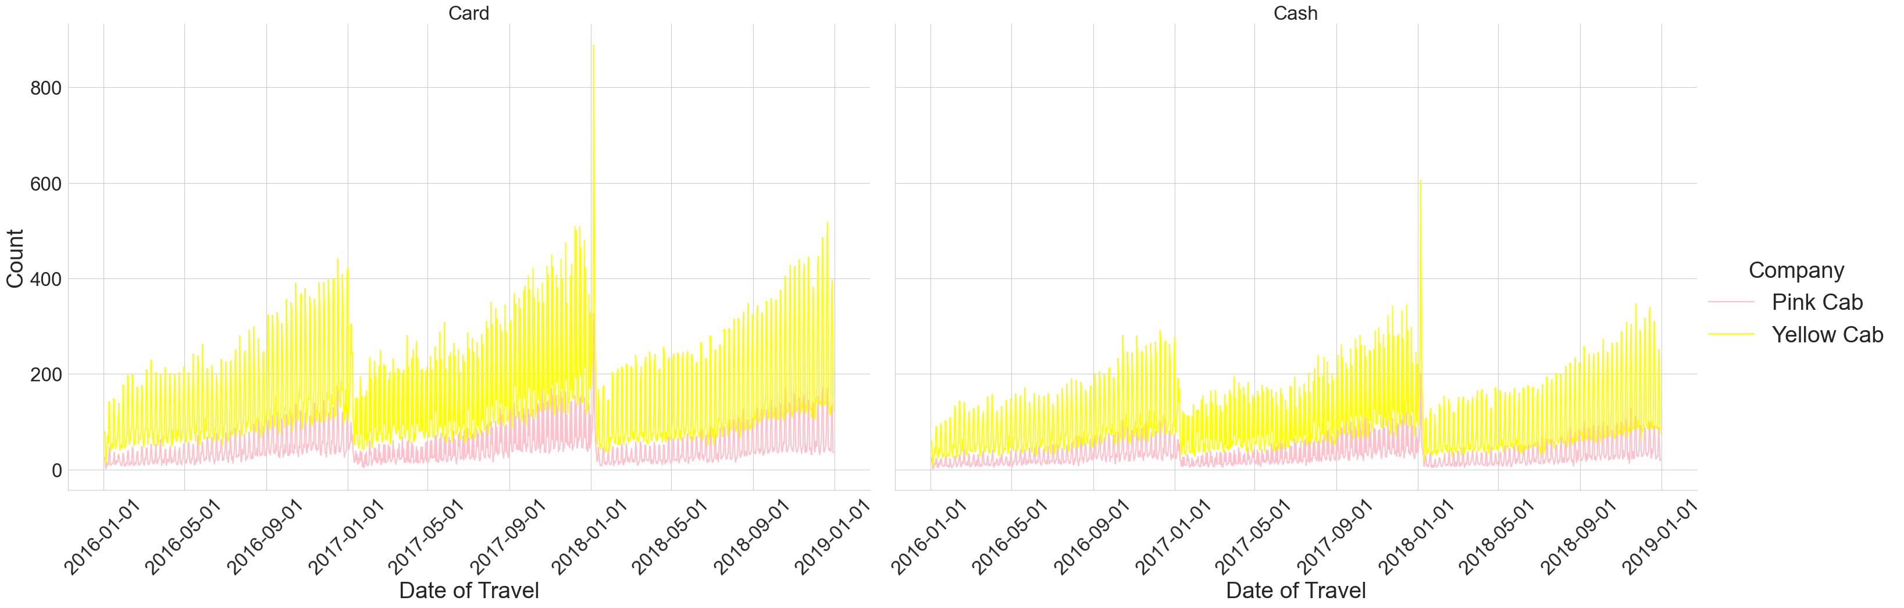
Line Plot of Payment Type by Time

Slide 16
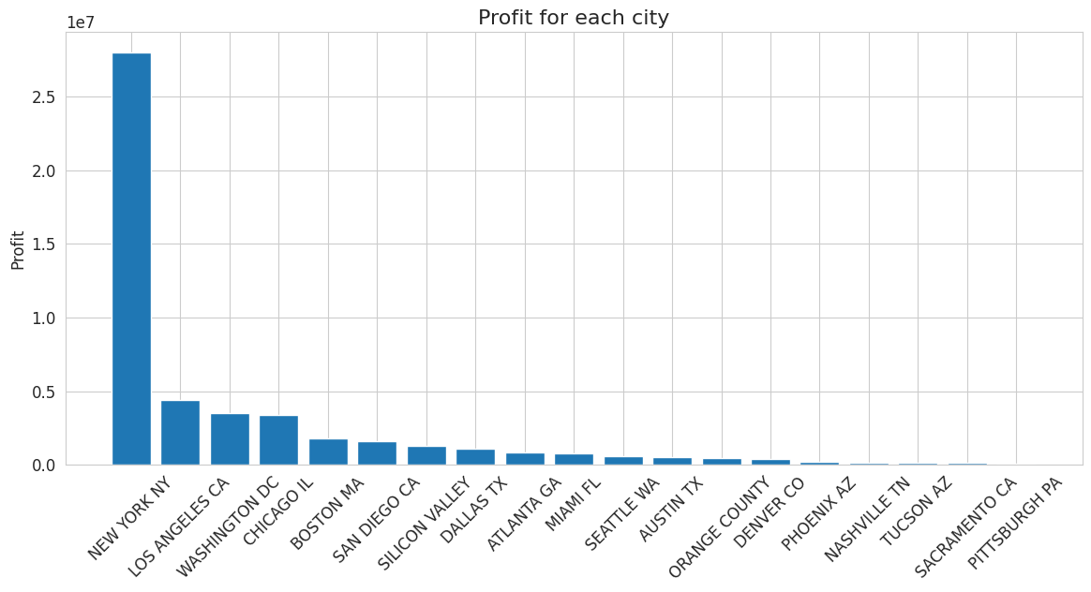
Bar Plot of Profit for Each City

Slide 17
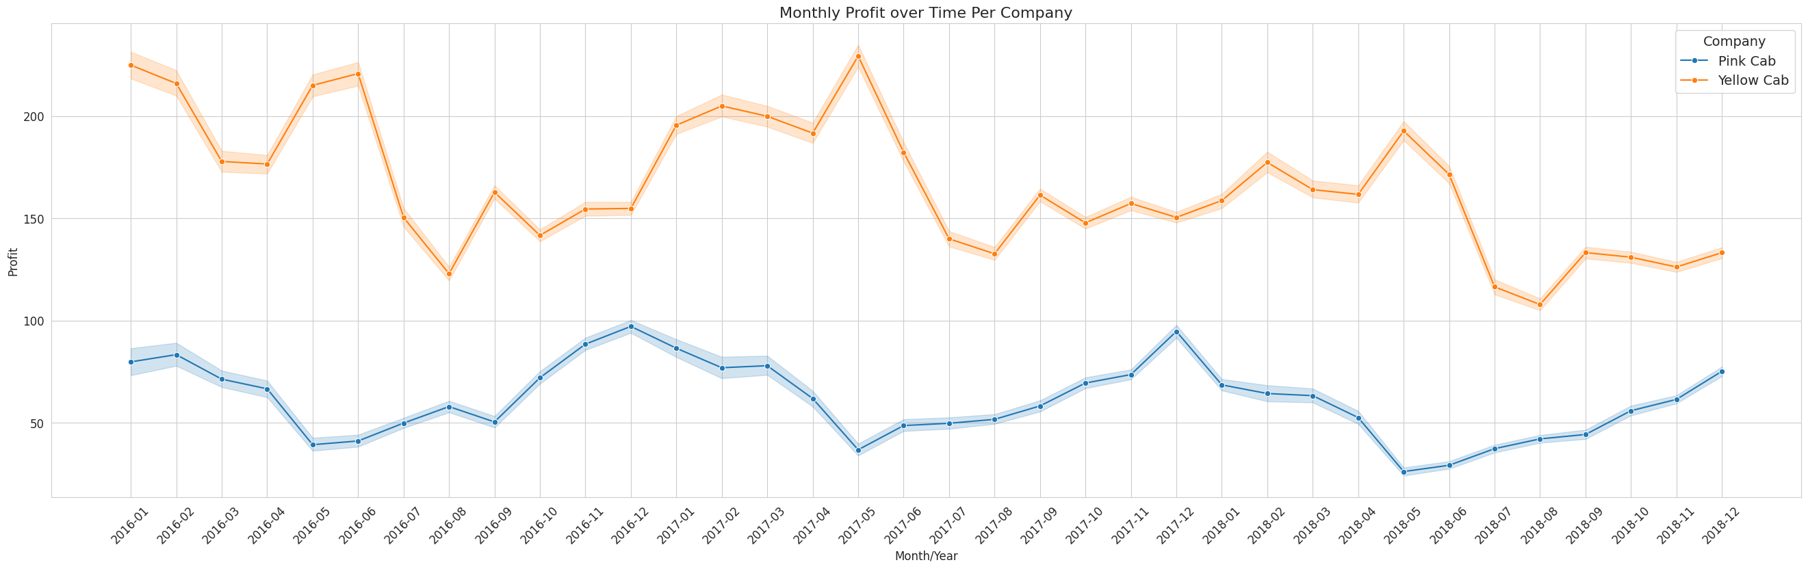
Line Plot of Payment Type by Time

Slide 18
EDA Summary
Yellow Cab is used more than Pink Cab. 76.4% of the rides are by Yellow Cab
November and December (10 and 12) have the most rides. Jan and Feb are the least
2018 has the highest cab rides, but the 'Year" column approximately has fairly distributed data

Slide 19
Recommendations
Since yellow cabs have the highest number of customers
It makes more profit overall, especially in cities like New York and Los Angeles.
XYZ should invest in the Yellow Cab company and devise more strategies to increase profits.
Through sign-up bonus for new users
Creating good deals for loyal cab users

Slide 20
Questions?
Thank You

